Slide 1
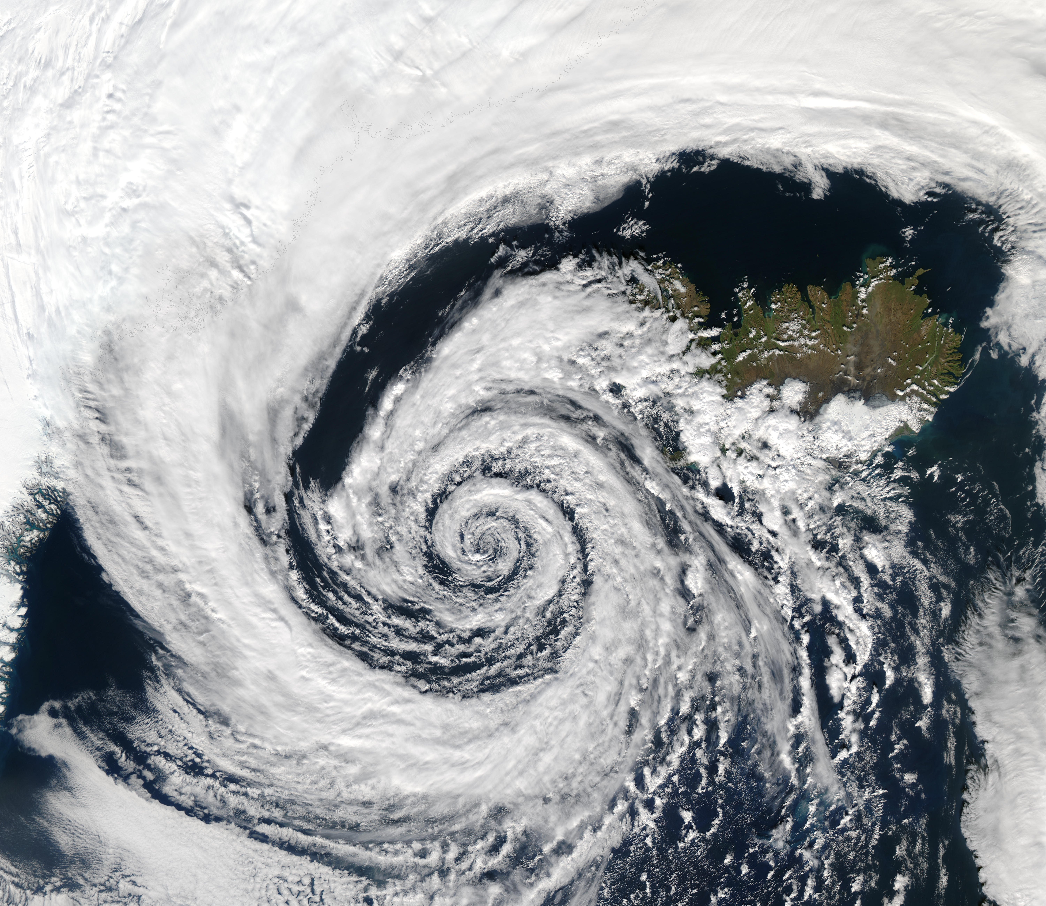

Synoptic and Dynamic Meteorology
Reanalysis : Part 2 – Maps
Nadia Kairaktidi
1068622

Slide 2
Introduction
Medicanes (Mediterranean hurricanes) are cyclones that are observed in the Mediterranean region and present characteristics similar to both tropical cyclones and mid-latitude frontal depressions. They are characterised by hurricane-force winds, horizontal pressure gradients and heavy precipitation and have a frequency of 1-2 per year. With the climate changing, it is hard to predict whether medicanes will show an increase or decrease in frequency, however, their intensity is expected to increase due to the warming of the Mediterranean sea which is their main energy source. They are usually created when an Atlantic low-pressure system passes over the Mediterranean basin and a high temperature gradient between the sea and the upper troposphere is present. This differentiates them from tropical cyclones that are observed mainly during the fall season were significant temperature gradients are observed. Medicanes, however, are not limited to a certain season and are smaller in size. (https://xaida.eu/.)
On September 27, 2018, an extratropical storm developed over the eastern Mediterranean Sea. Initially forming as an extratropical cyclone, the system encountered warm sea surface temperatures of approximately 27°C, which facilitated its transition into a hybrid cyclone characterized by a warm thermal core at its center. As the storm progressed northeastward toward Greece, it gradually intensified and exhibited features associated with tropical cyclones. On September 29, the system reached peak intensity and made landfall in the Peloponnese region, west of Kalamata, with a recorded minimum central pressure of 989.3 mbar. The storm continued to strengthen as it advanced northward through Greece. The extreme rainfall and subsequent flash flooding associated with the medicane resulted in significant casualties, with five fatalities reported in Tunisia. Additionally, in Greece, one person was confirmed dead, while two others were reported missing (https://en.wikipedia.org/).

Slide 3
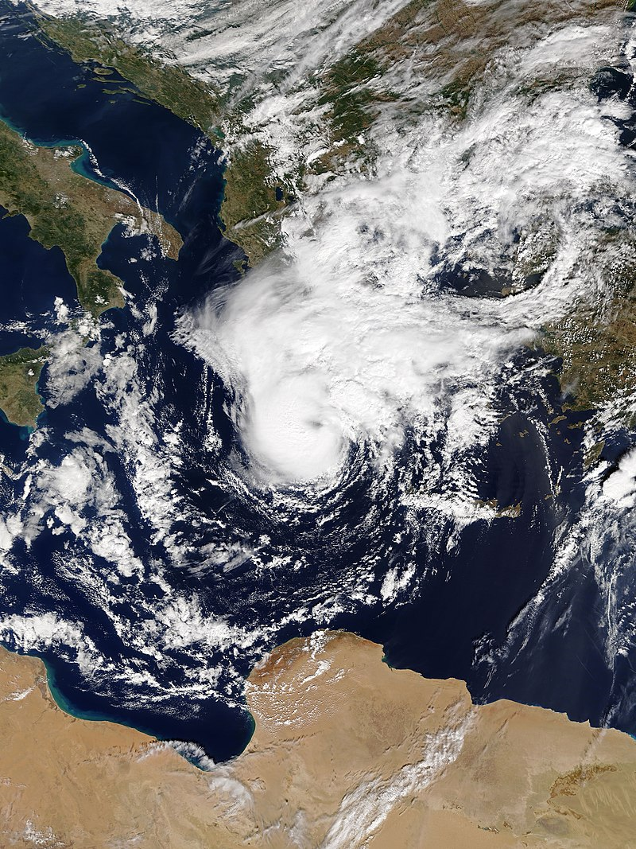
TASK a)
From its initial formation to the point at which it fully developed tropical-like characteristics, Zorbas caused significant damage due to intense winds, heavy rainfall, widespread flooding, and even tornadoes. The most severely affected areas were in southern Greece, particularly Crete, the Peloponnese, Evia, and the region surrounding Athens (https://wcd.copernicus.org/).
The first objective of this assignment is to analyse the evolution of the medicane through a series of maps illustrating sea level pressure (SLP) isobars and wind barbs at the 1000 hPa level within a single diagram. The dataset used for this analysis was obtained from the Copernicus Climate Data Store and includes hourly values for the period from September 27 to September 30. In accordance with standard practice for studying the development of medicanes, we have generated figures at six-hour intervals to effectively capture the storm’s progression.
Picture : Zorbas at peak intensity over the Ionian Sea (https://en.wikipedia.org/).

Slide 4
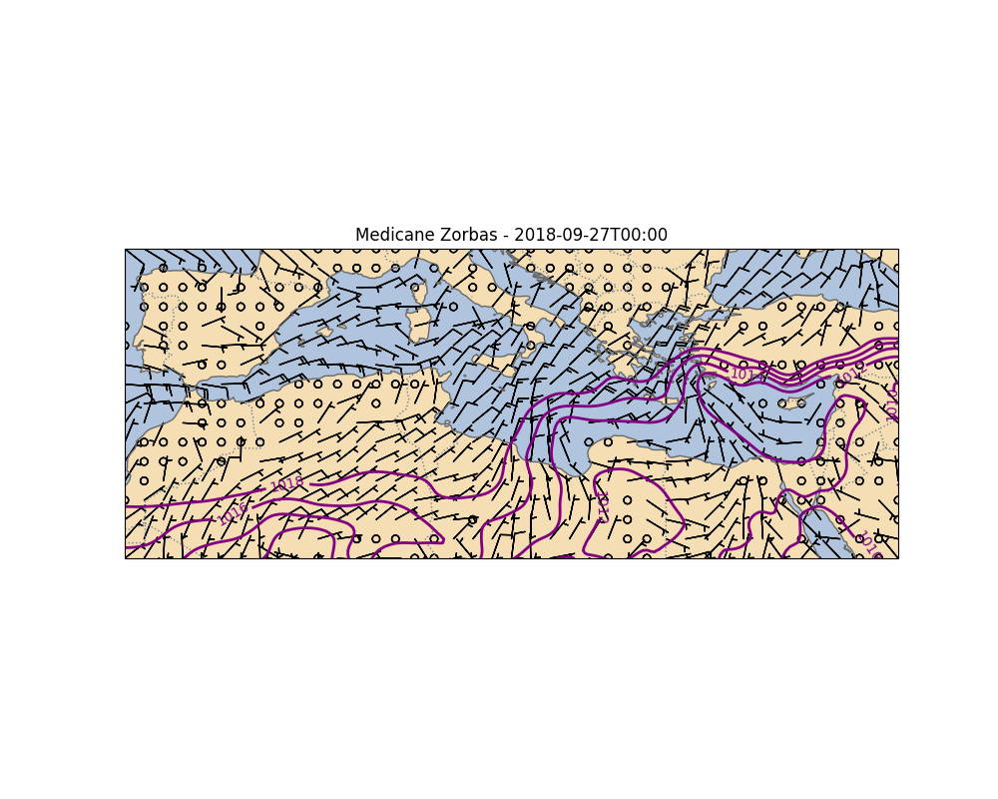

Slide 5
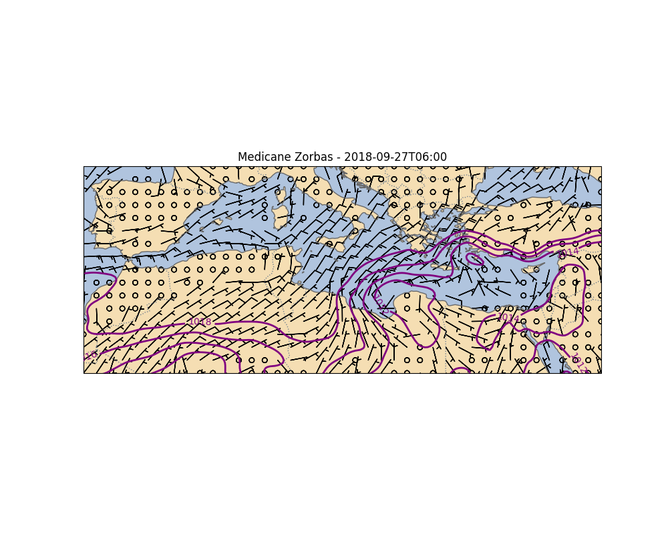

Slide 6
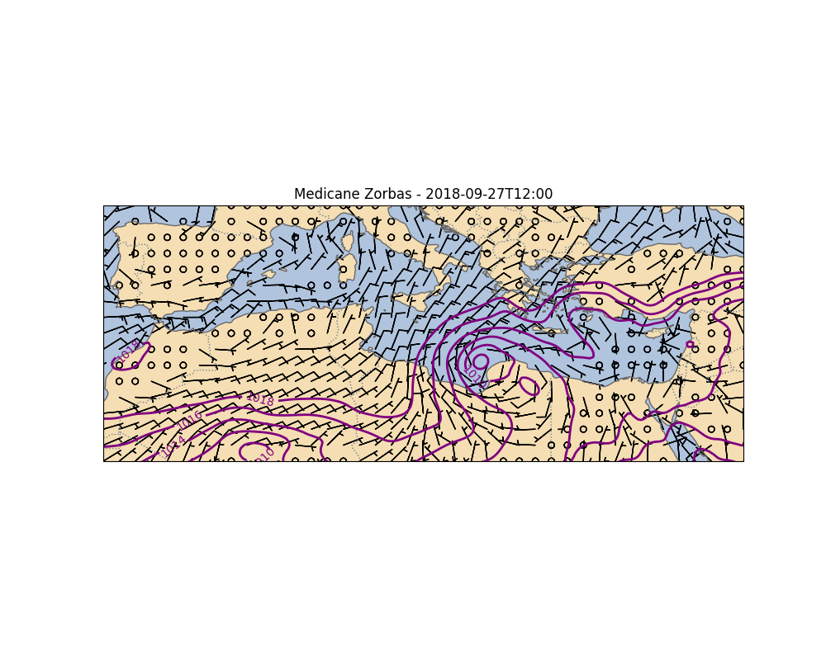

Slide 7
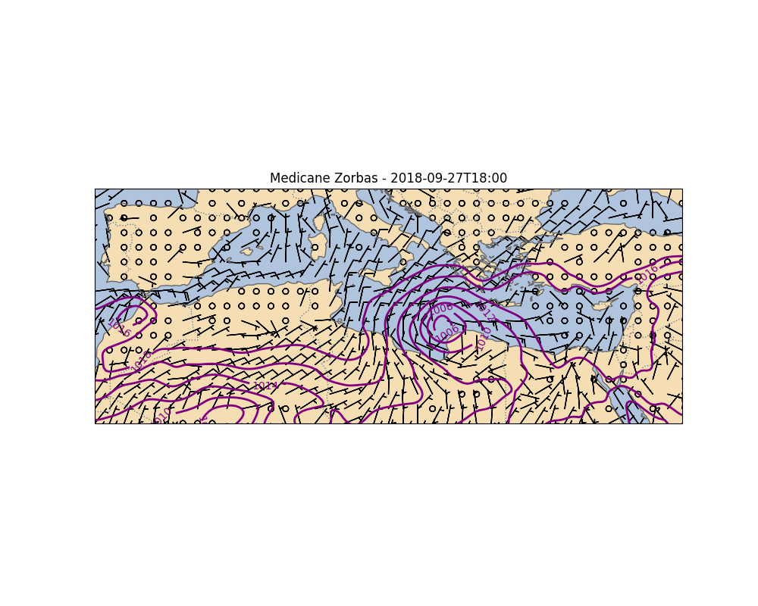

Slide 8
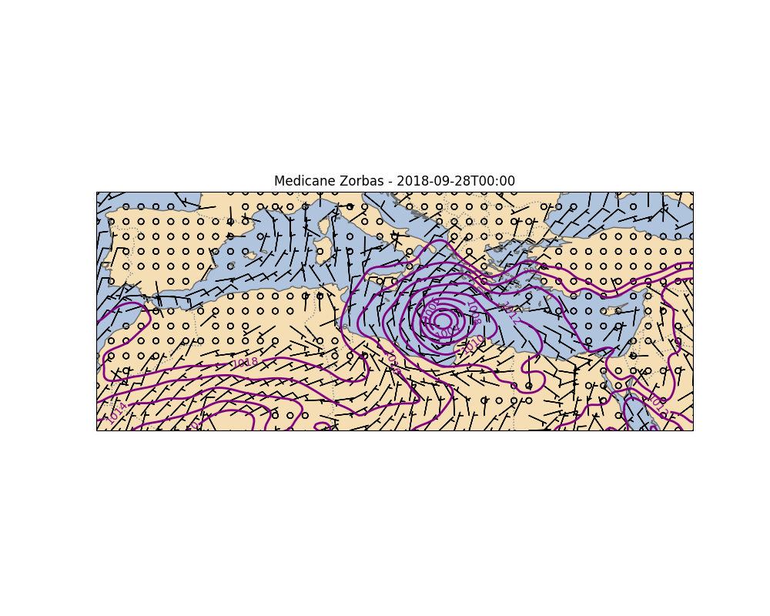

Slide 9
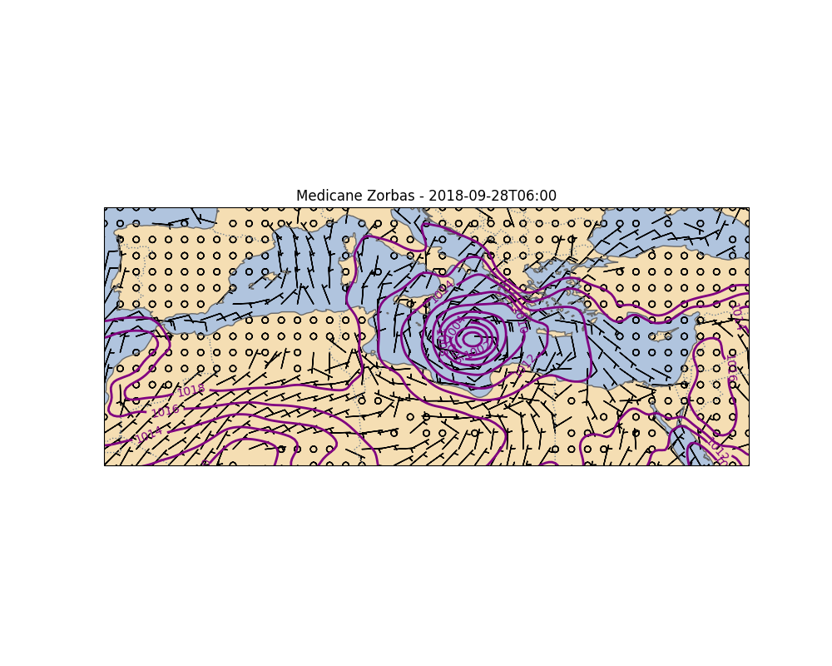

Slide 10
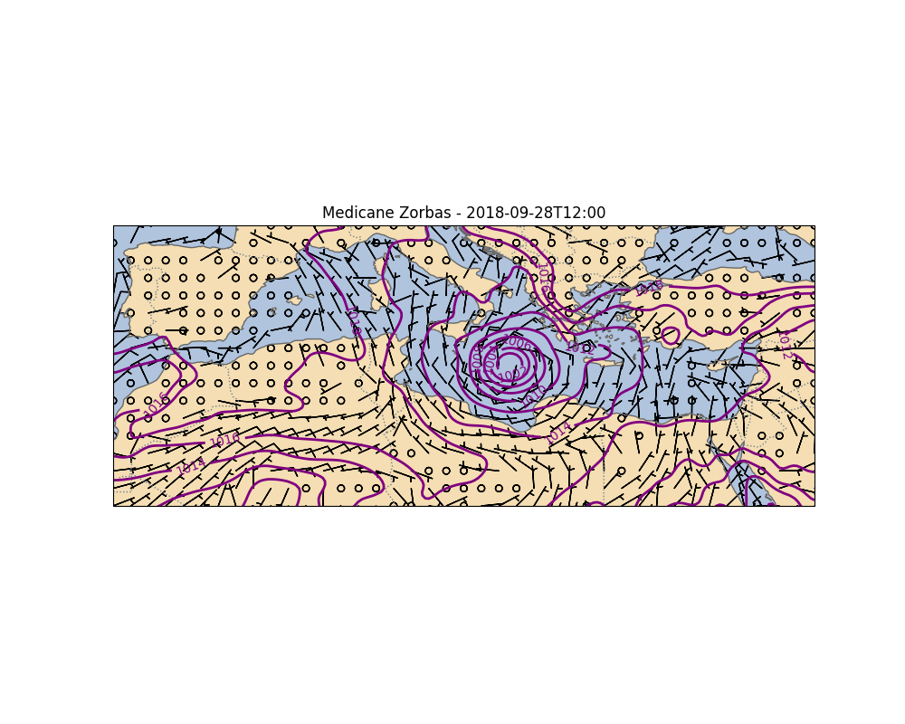

Slide 11
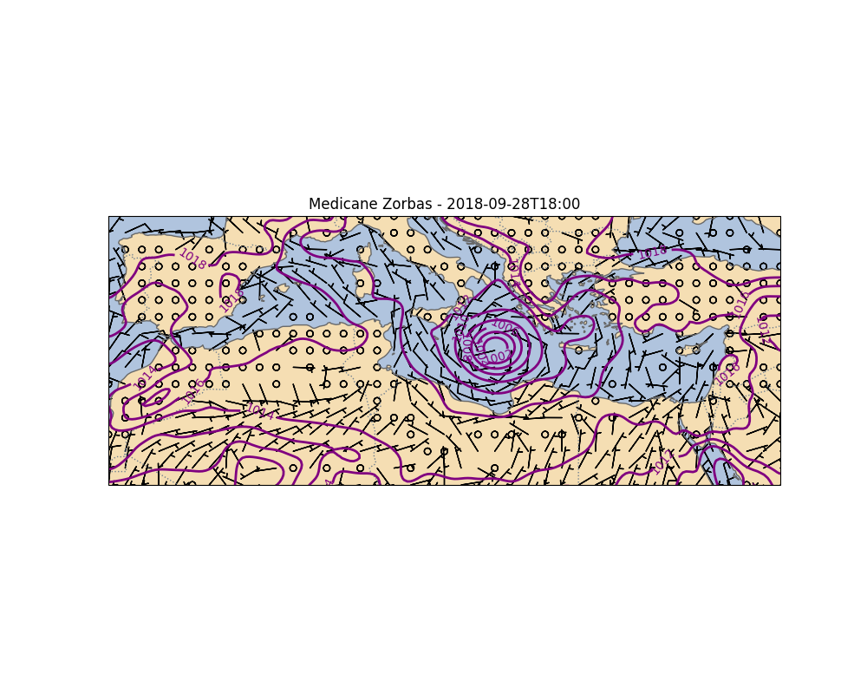

Slide 12
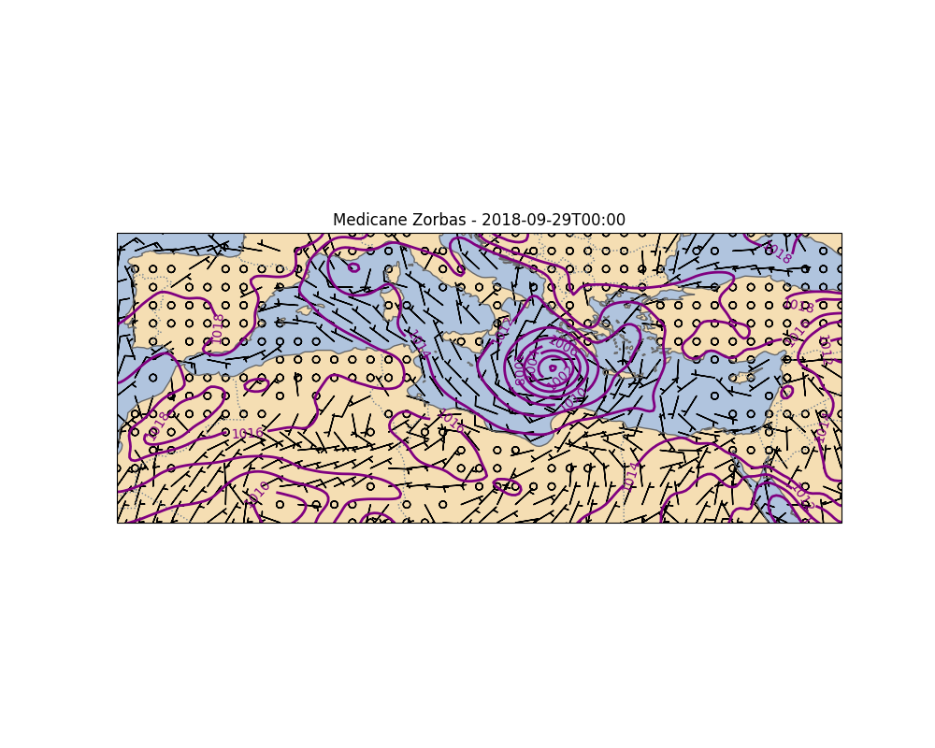

Slide 13
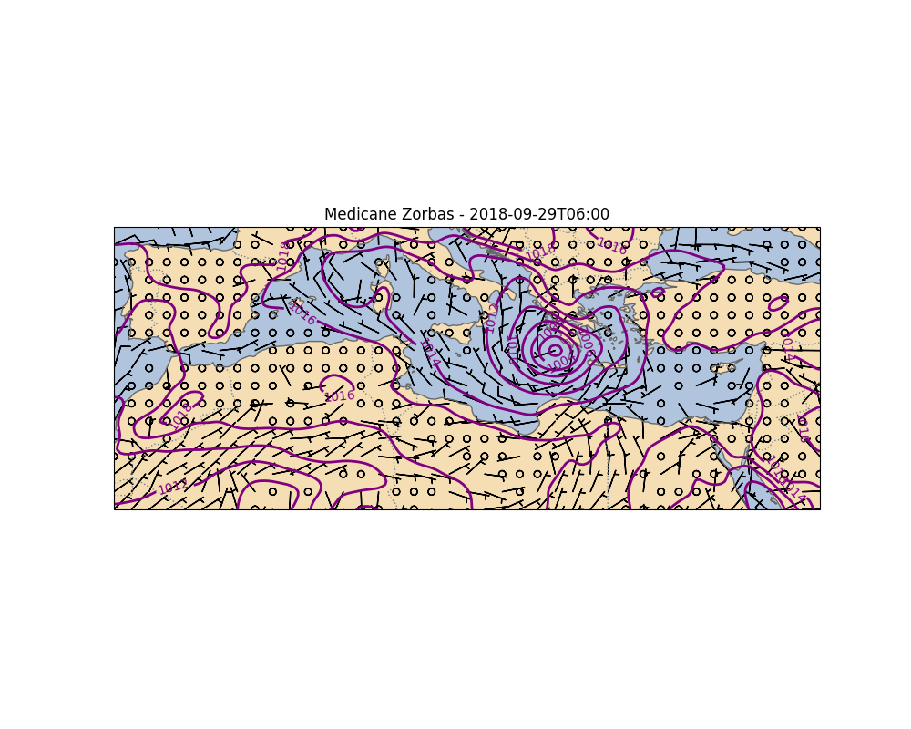

Slide 14
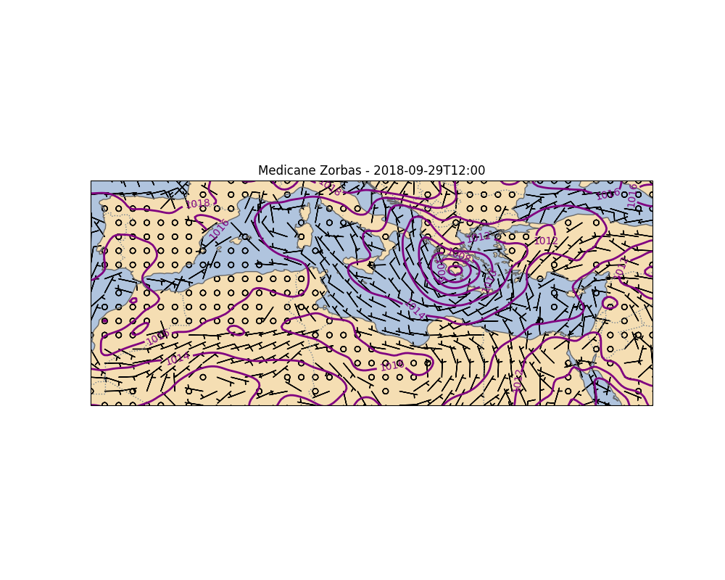

Slide 15
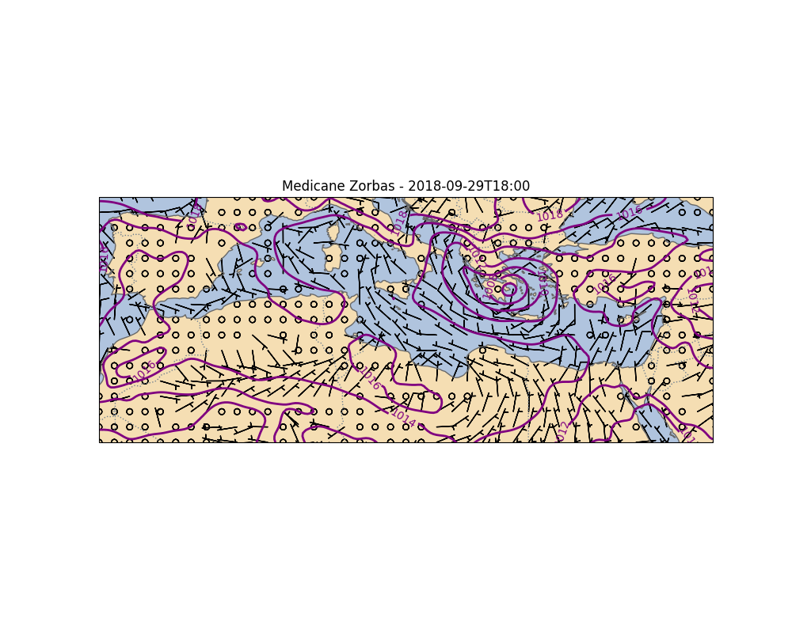

Slide 16
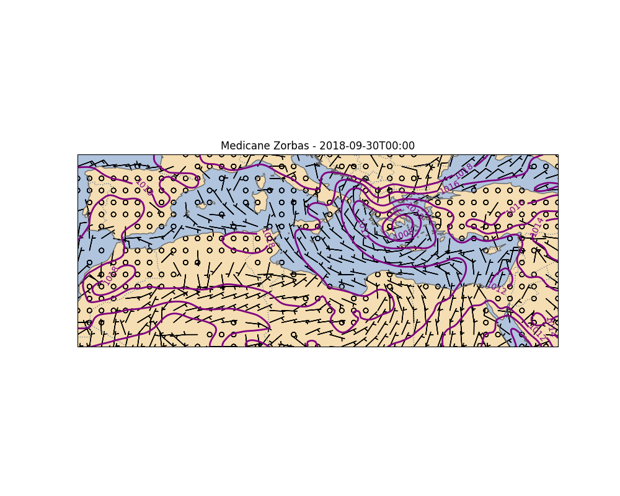

Slide 17
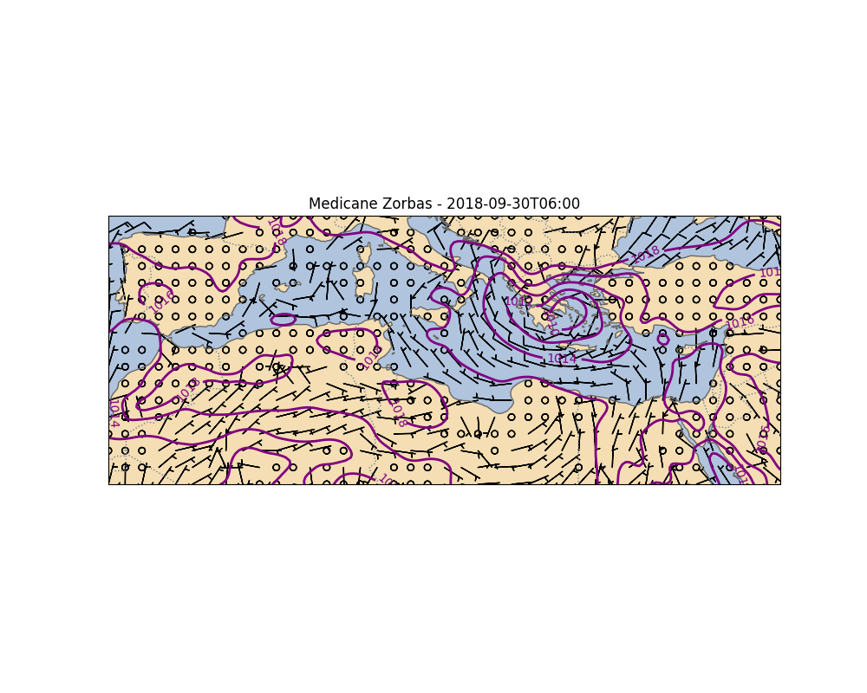

Slide 18
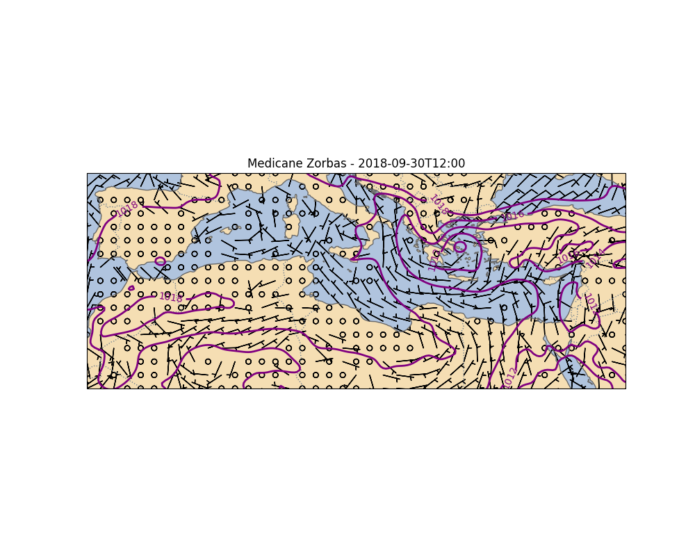

Slide 19
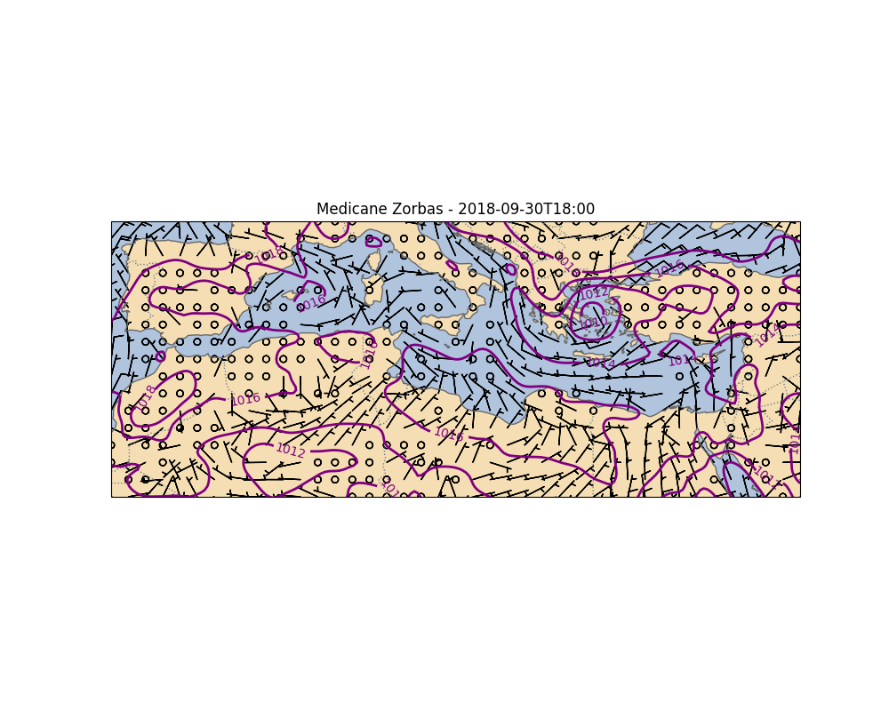

Slide 20


Slide 21
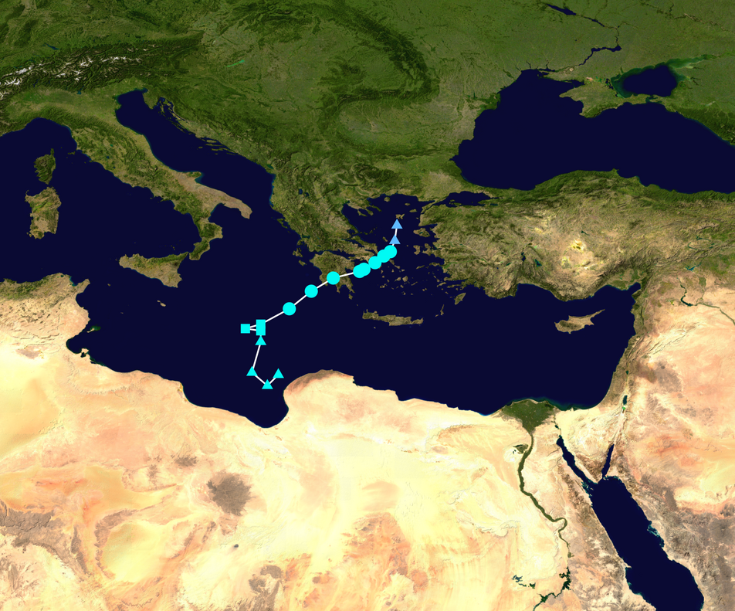
Observations and TASK b)
The progression of the medicane is clearly observed as it moves northeastward toward Greece, reaching its peak intensity on September 29. Following landfall, the system continued its trajectory into the Aegean Sea, accelerating northeastward over northwestern Turkey before eventually dissipating.
In the following analysis, we focus on a specific time and date to calculate the relative vorticity at 1000 hPa, based on its standard definition. According to the literature, Medicane Zorbas reached its peak intensity while passing over Greece on September 29. At this time, the maximum recorded wind speed was 120 km/h, and the minimum central pressure was 987 hPa. Using this information, we analyse the maps from the previous task to identify the exact moment when the system reached peak intensity, which is expected to correspond with high relative vorticity. Based on this assessment, the selected time for analysis is 06:00 UTC, and the corresponding results are visualized in the map presented on the next slide.
Picture : Map plotting the storm's track and intensity, according to the Saffir–Simpson scale showMap key (https://en.wikipedia.org/).

Slide 22
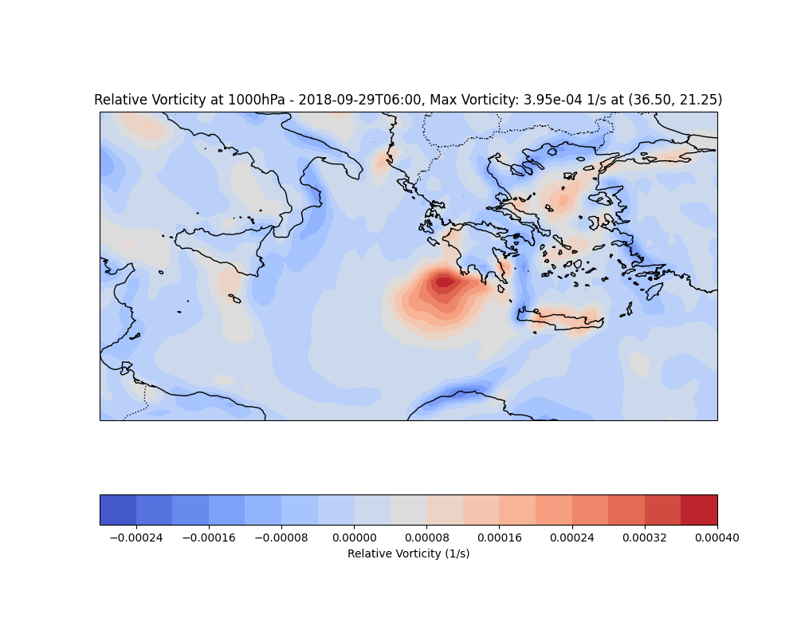

Slide 23
Observations and TASK c)
Vorticity can be induced in air parcels due to the characteristics of the surrounding flow, a phenomenon known as relative vorticity. This type of vorticity arises from the presence of troughs, ridges, and variations in horizontal wind speed. As air flows through a trough, it exhibits cyclonic motion, resulting in positive relative vorticity. Conversely, airflow within a ridge is anticyclonic, leading to negative relative vorticity (https://www.weather.gov/).
In this analysis, we calculated the relative vorticity on September 29 at 06:00 UTC and determined its value to be 3.95 × 10⁻⁴ rotations per second . As expected, the vorticity is positive in the vicinity of the medicane, consistent with its cyclonic nature. The exact coordinates of the maximum vorticity are indicated on the corresponding map.
Finally, we compare the relative vorticity calculated in the previous task with the corresponding values obtained from the Climate Data Store (CDS) and analyse their similarities and differences. To achieve this, we subtract the computed relative vorticity from the CDS-derived values. The resulting figure illustrates that around the medicane’s eye, there is a predominance of red over blue, indicating that the CDS data generally yields slightly higher vorticity values than our calculations. The colormap axis reaches a maximum value of 1.6 × 10⁻⁴ rotations per second, prompting further statistical analysis to assess the differences between the two methods.
On the next slide, a map illustrating these differences is presented, followed by a brief statistical analysis to further explore the relationship between the two datasets.

Slide 24
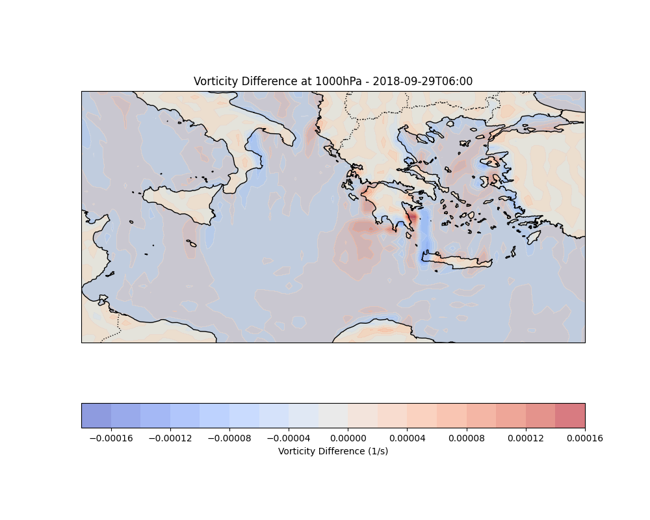

Slide 25
Statistical Analysis
The statistical analysis provides valuable insights into the differences between our computed relative vorticity and the corresponding values from the Climate Data Store (CDS).
The Mean Absolute Error (MAE) = 0.000004 indicates that, on average, our calculations deviate only slightly from the CDS data, while the Root Mean Squared Error (RMSE) = 0.000008 suggests that larger deviations, though minimal, have a slightly greater impact on the overall discrepancy. Additionally, the Pearson’s Correlation Coefficient = 0.9795 confirms a strong linear relationship between the two datasets, indicating that both methods capture the vorticity distribution with high consistency.
The slight discrepancies observed, particularly around the medicane’s eye where the CDS data exhibits slightly higher values, may be attributed to differences in spatial and temporal resolution, numerical approximations, or variations in computational methods. The CDS dataset may utilize different interpolation techniques, leading to these minor differences. Additionally, model assumptions, such as boundary conditions and data assimilation processes, could contribute to the observed variations. Nonetheless, the high correlation and low error values indicate that our calculations align well with the reference dataset, validating the reliability of our approach.

Slide 26
The presentation’s code, along with all associated files, will be available at the following link after the submission deadline : https://github.com/nadezsha/
Datasets :
Single levels : https://cds.climate.copernicus.eu/datasets/reanalysis-era5-single-levels?tab=overview
Pressure levels : https://cds.climate.copernicus.eu/datasets/reanalysis-era5-pressure-levels?tab=overview
All references are accessible via clickable links throughout the presentation slides.

